Slide 1
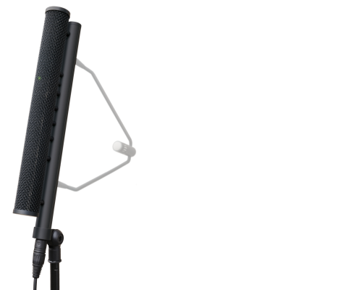
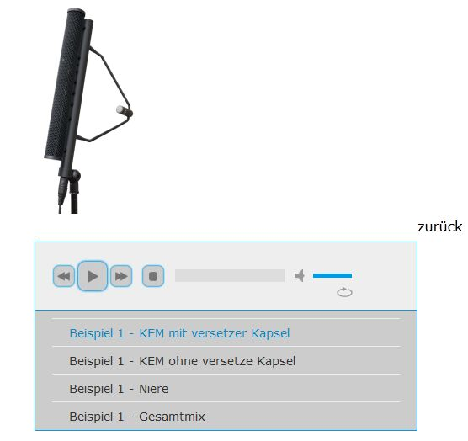
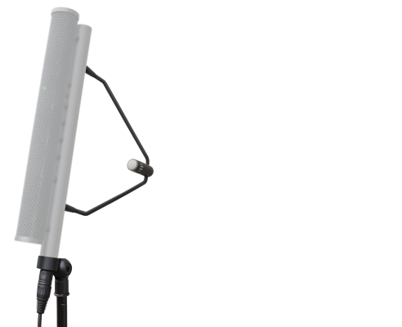
Sound clips Comparing four versions
Improving the Low Frequency Directivity of Line-Array Microphones
KEM without offset capsule
KEM with offset capsule
Cardioid
Included examples: Handel’s “Messiah” recorded in St. Sebastian’s church, Munich in November 2011
Click on the “loudspeakers” to listen to the clips – three different sections defined by the “loudspeaker” colour
Overall mix

Slide 2
Thank you for listening
Udo Wagner
Sales Manager
John Willett
Managing Director
Microtech Gefell GmbH
Georg-Neumann-Platz
07926 Gefell
Germany
Tel. +49-(0)36649-882-20
Fax +49-(0)36649-882-11
E-Mail: u.wagner@microtechgefell.de
Sound-Link ProAudio
Bicester
Oxfordshire
UK
Tel. +44-(0)1869-600-817
Mob: +44-(0)7973-633-634
E-Mail: john@sound-link.co.uk

Slide 3
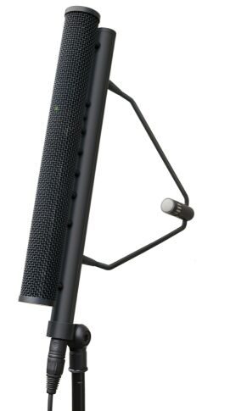
Thank you for listening
Sebastian Goossens
Produktionssysteme Audio
Institut für Rundfunktechnik
Floriansmühlstraße 60
80939 München
Deutschland
Tel. +49-(0)89-32399-358
Fax +49-(0)89-32399-415
E-Mail: goossens@irt.de
This presentation, including pictures and diagrams, is protected by copyright Reproduction is only permitted with the specific permission of the author (S. Goossens) This copyright notice must not be removed from the presentation

